Slide 1
FHIR-Based Postnatal Care (PNC) Digitalisation Project
HIMS 505: Telecare, Medical Signal and Imaging
Masters in Health Informatics
Department of Health Informatics
Batch 2024
Kathmandu University
Group 1: Lasata Maharjan, Lochana Bhusal, Nischal Lamichhane, Surakshya Amatya

Slide 2
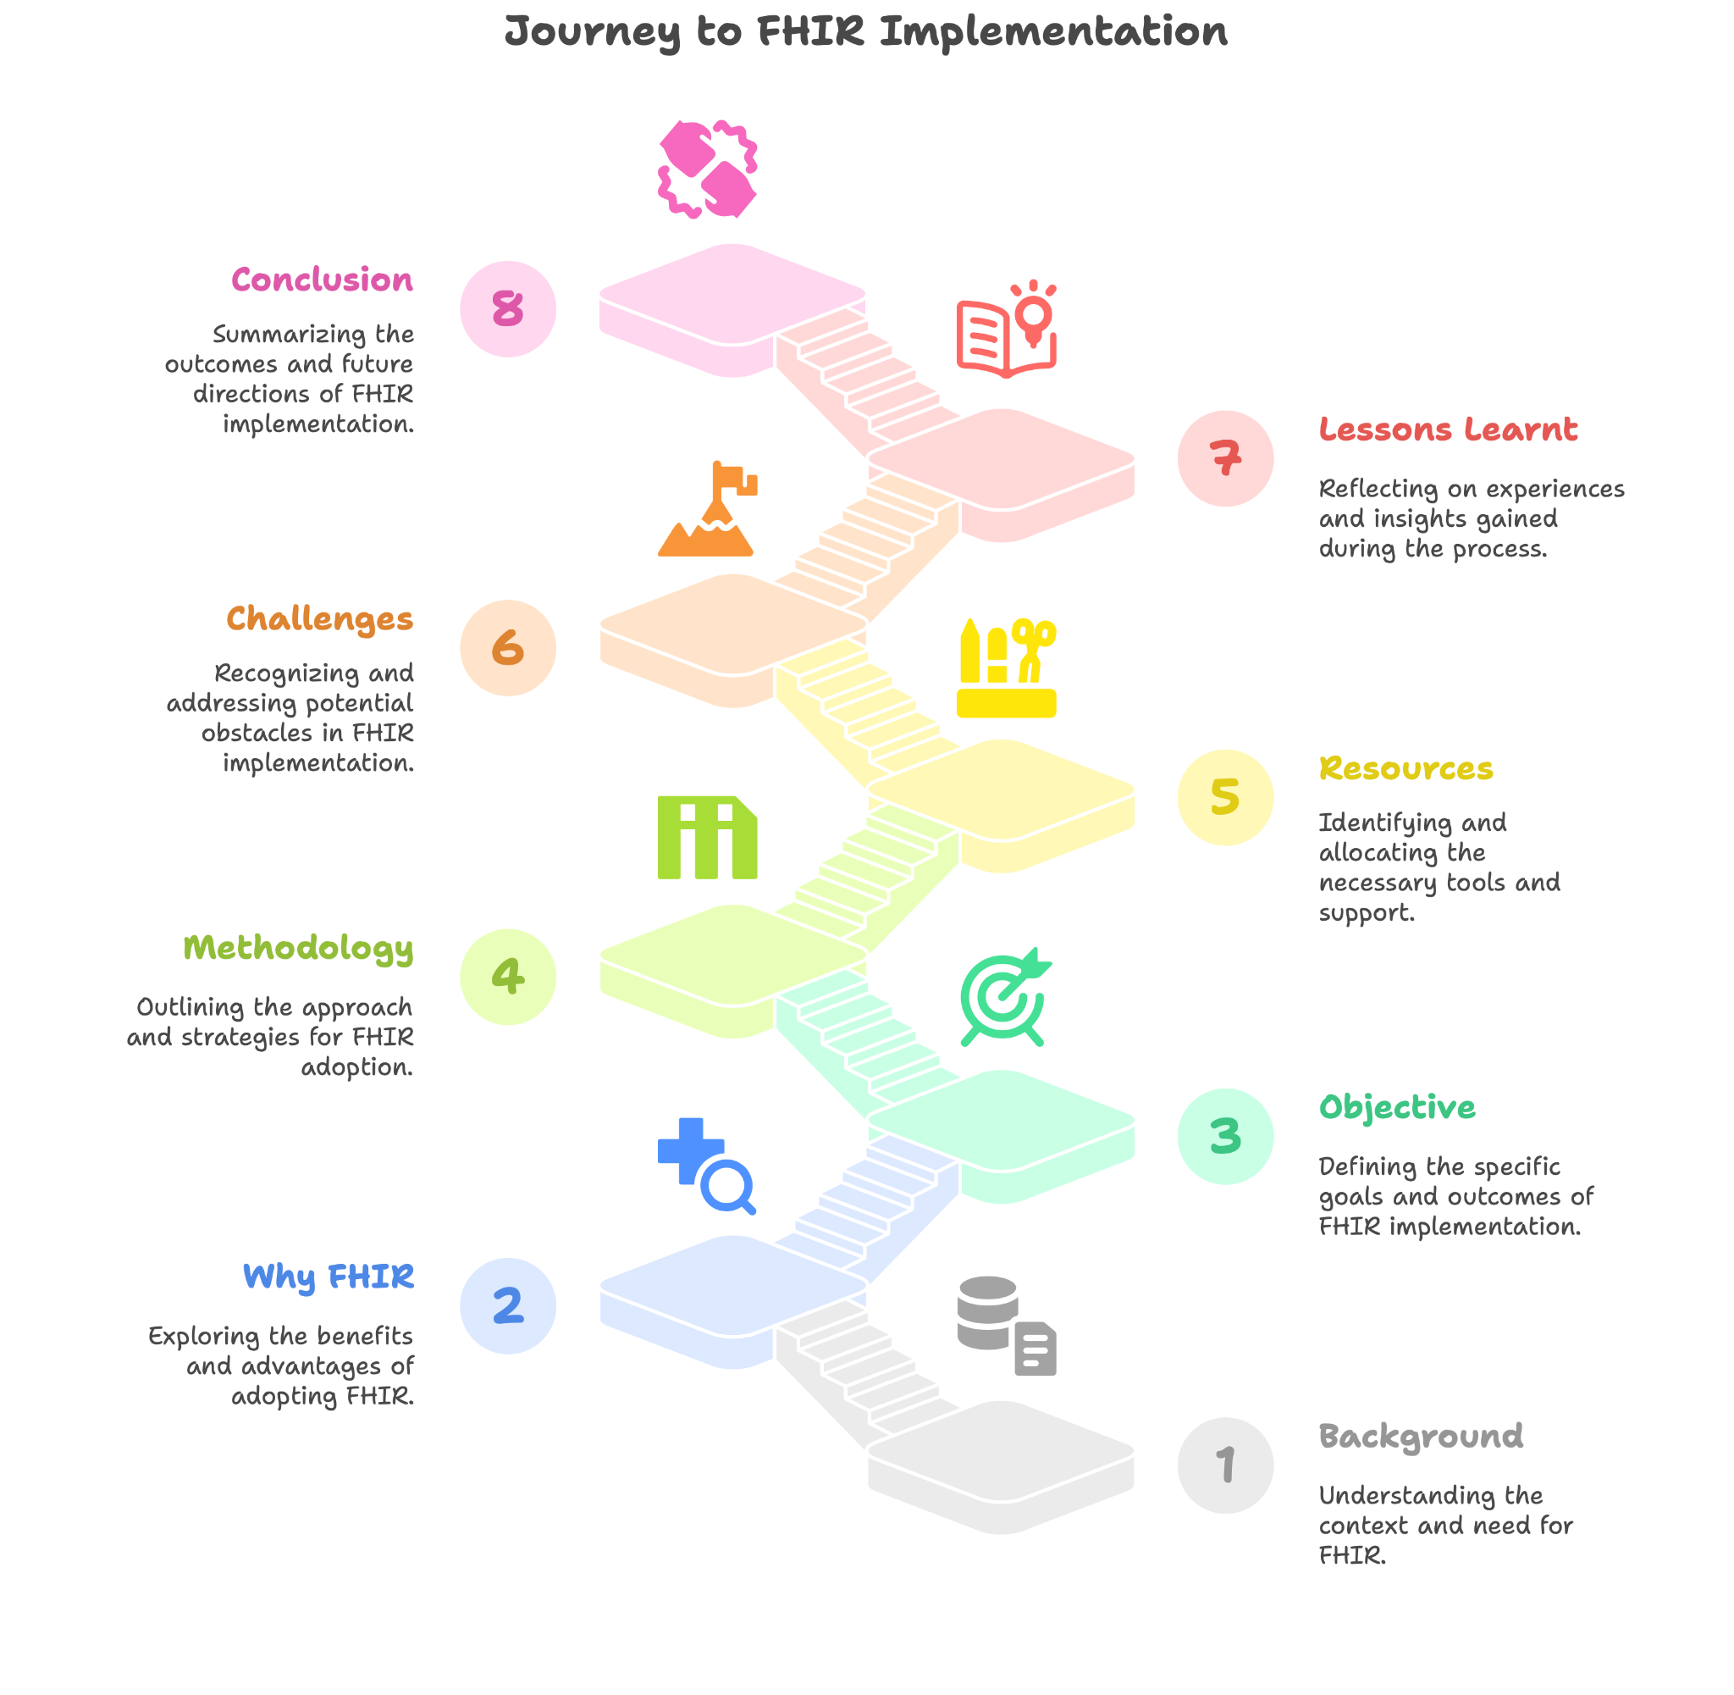
What will we talk about today?

Slide 3
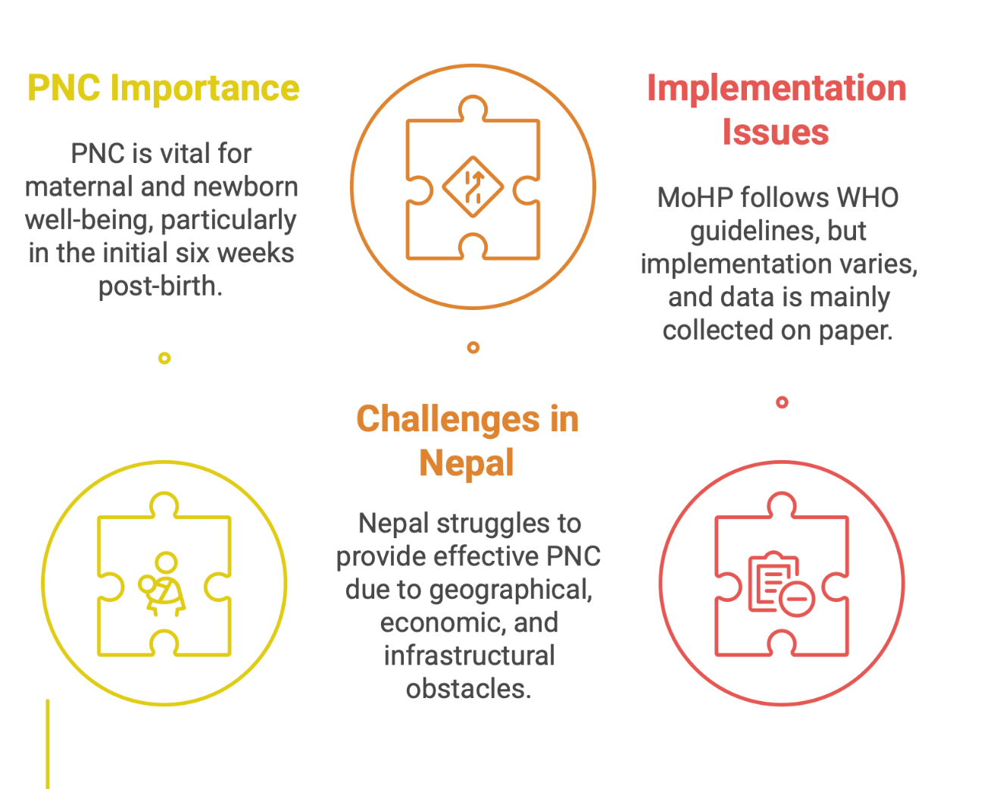
Background of PNC in Nepal
PNC is critical for maternal and newborn health, especially in the first six weeks after birth.
Nepal faces challenges in delivering effective PNC due to geographic, socio-economic, and infrastructural barriers.
The Ministry of Health and Population (MoHP) has adopted WHO PNC guidelines, but implementation is inconsistent, and data collection is often paper-based.

Slide 4
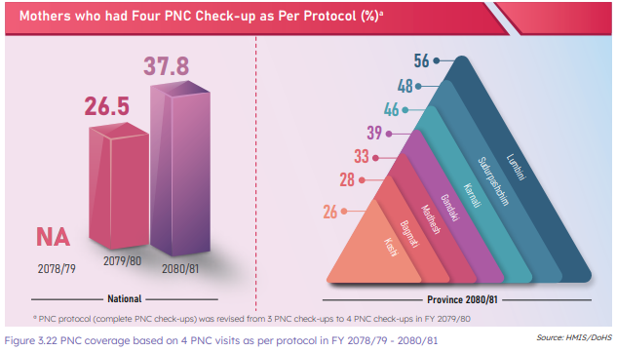
Current Scenario of PNC in Nepal
Notes:
Source: DoHS Annual Report, 2080/81

Slide 5
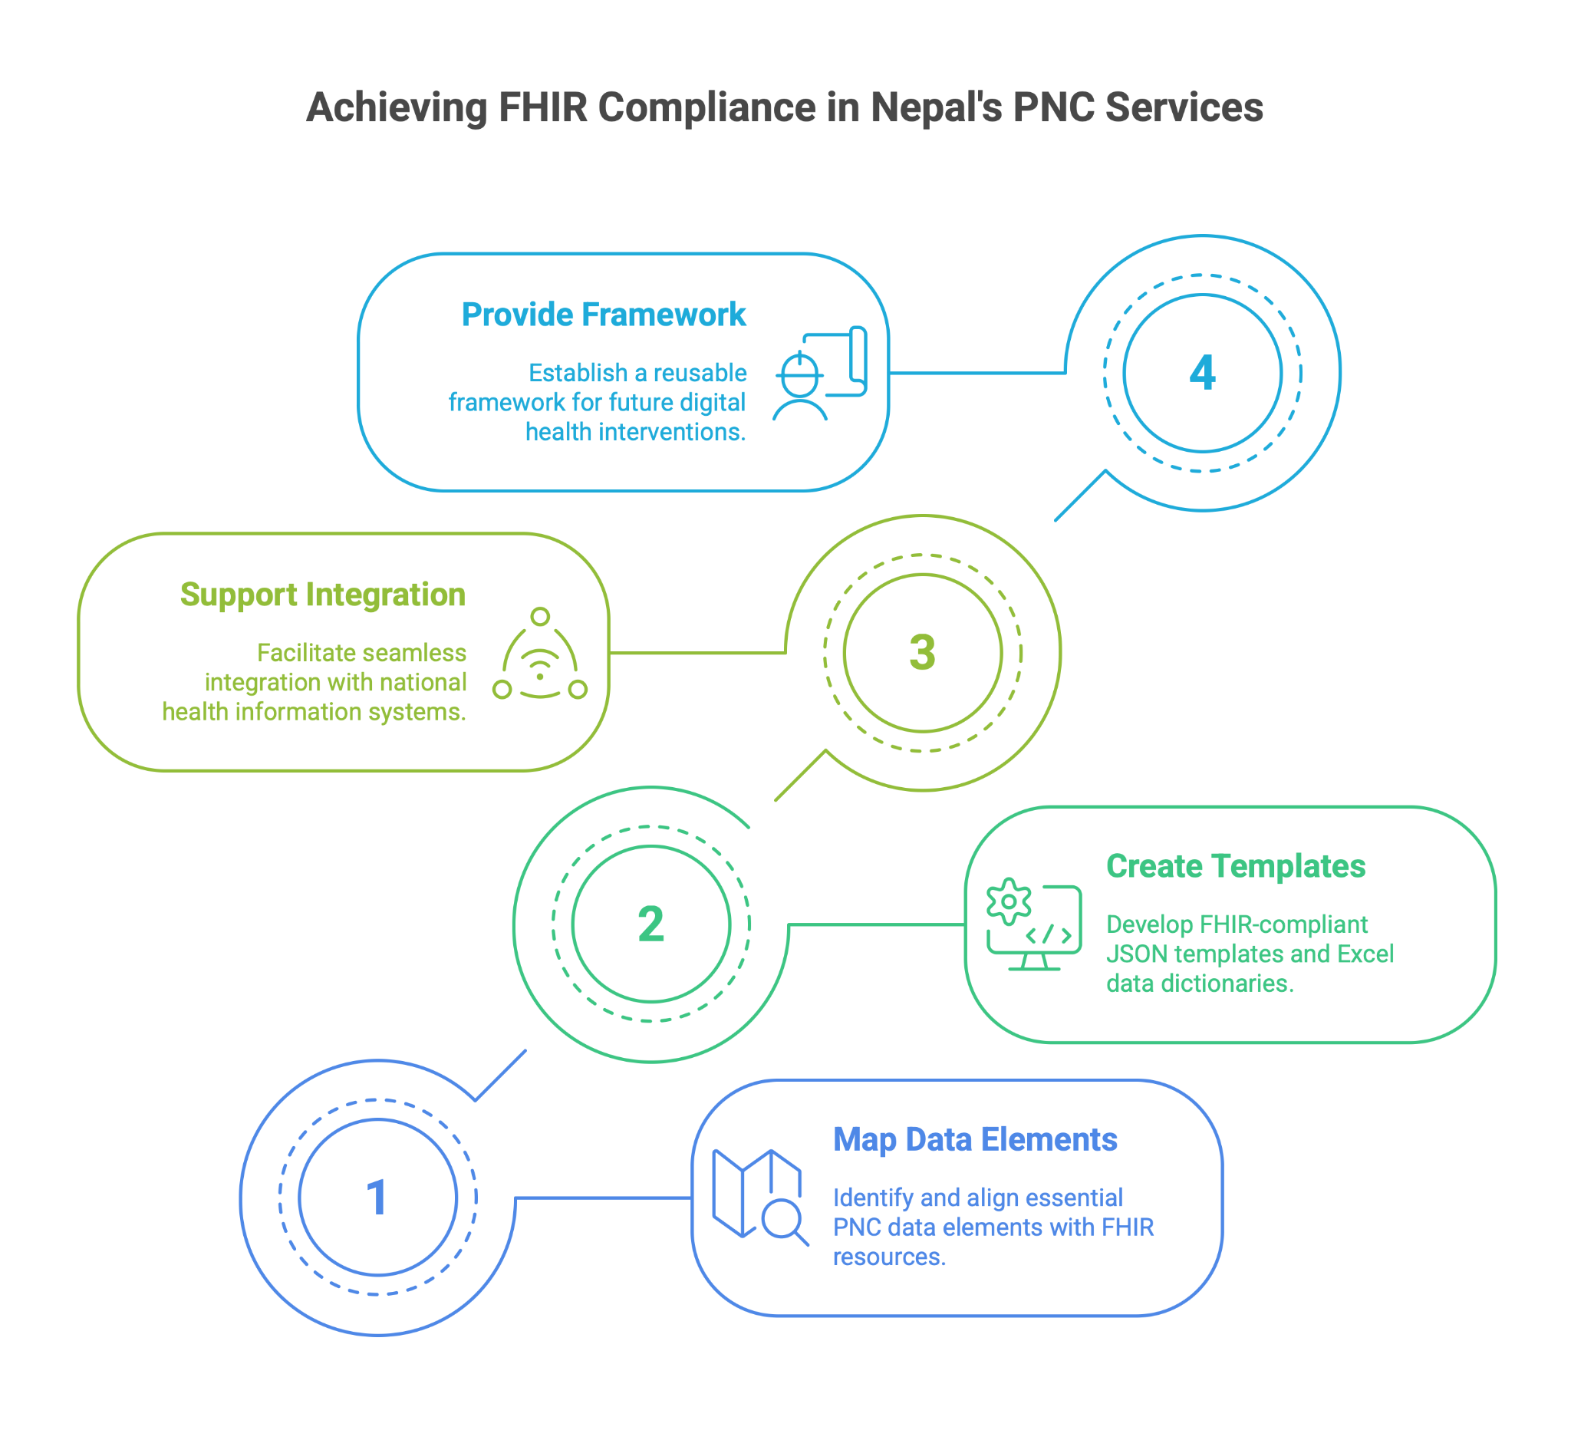
Project Objective
General Objective
Develop a structured, FHIR compliant data model for documenting PNC services in Nepal.

Slide 6
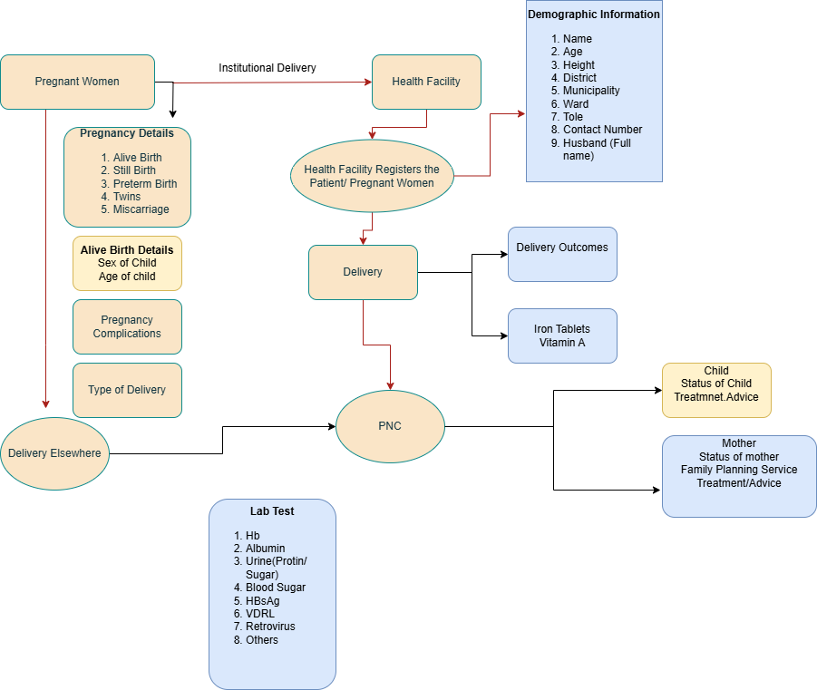
PNC Journey

Slide 7
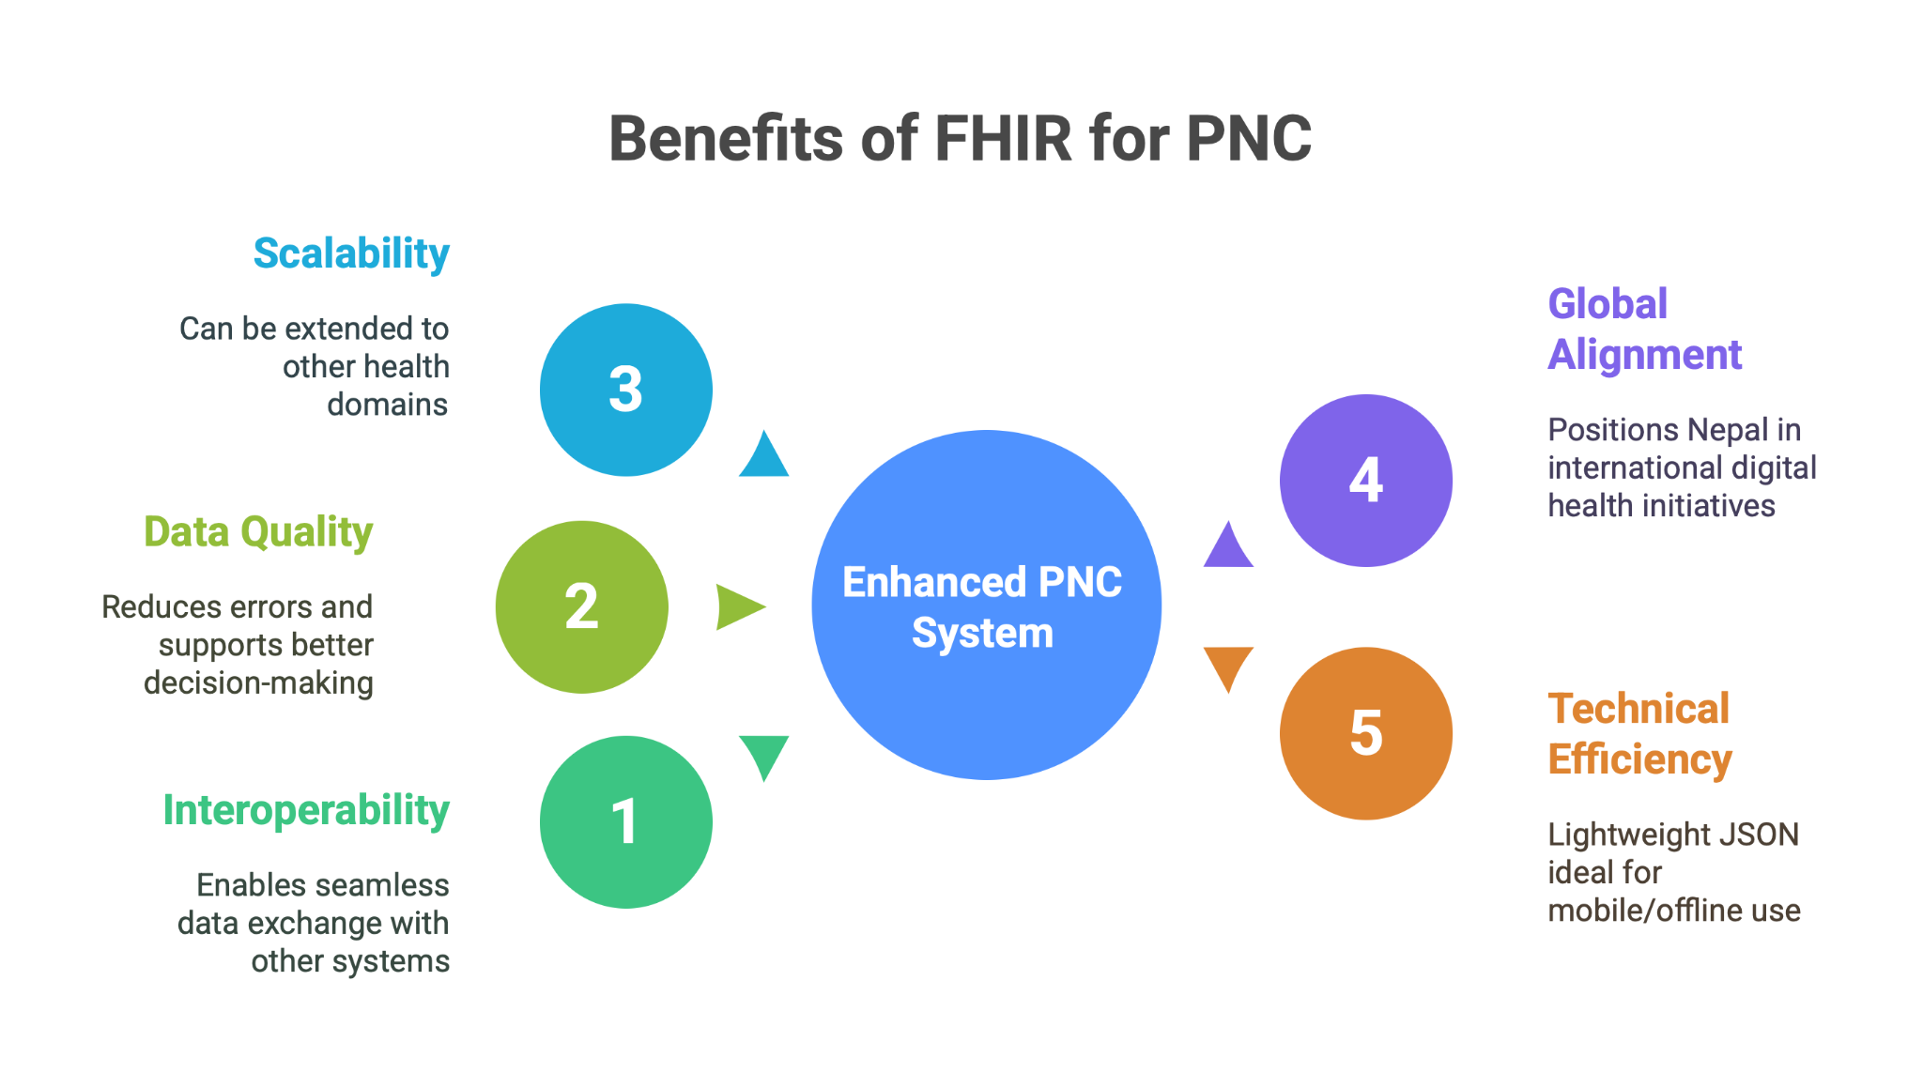

Slide 8
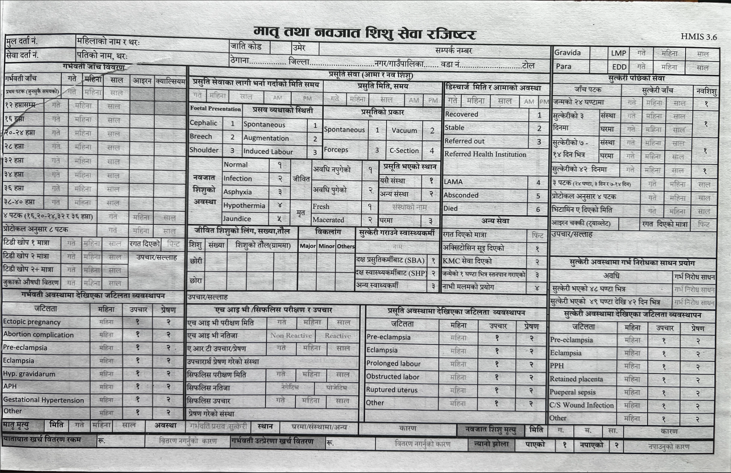

Slide 9
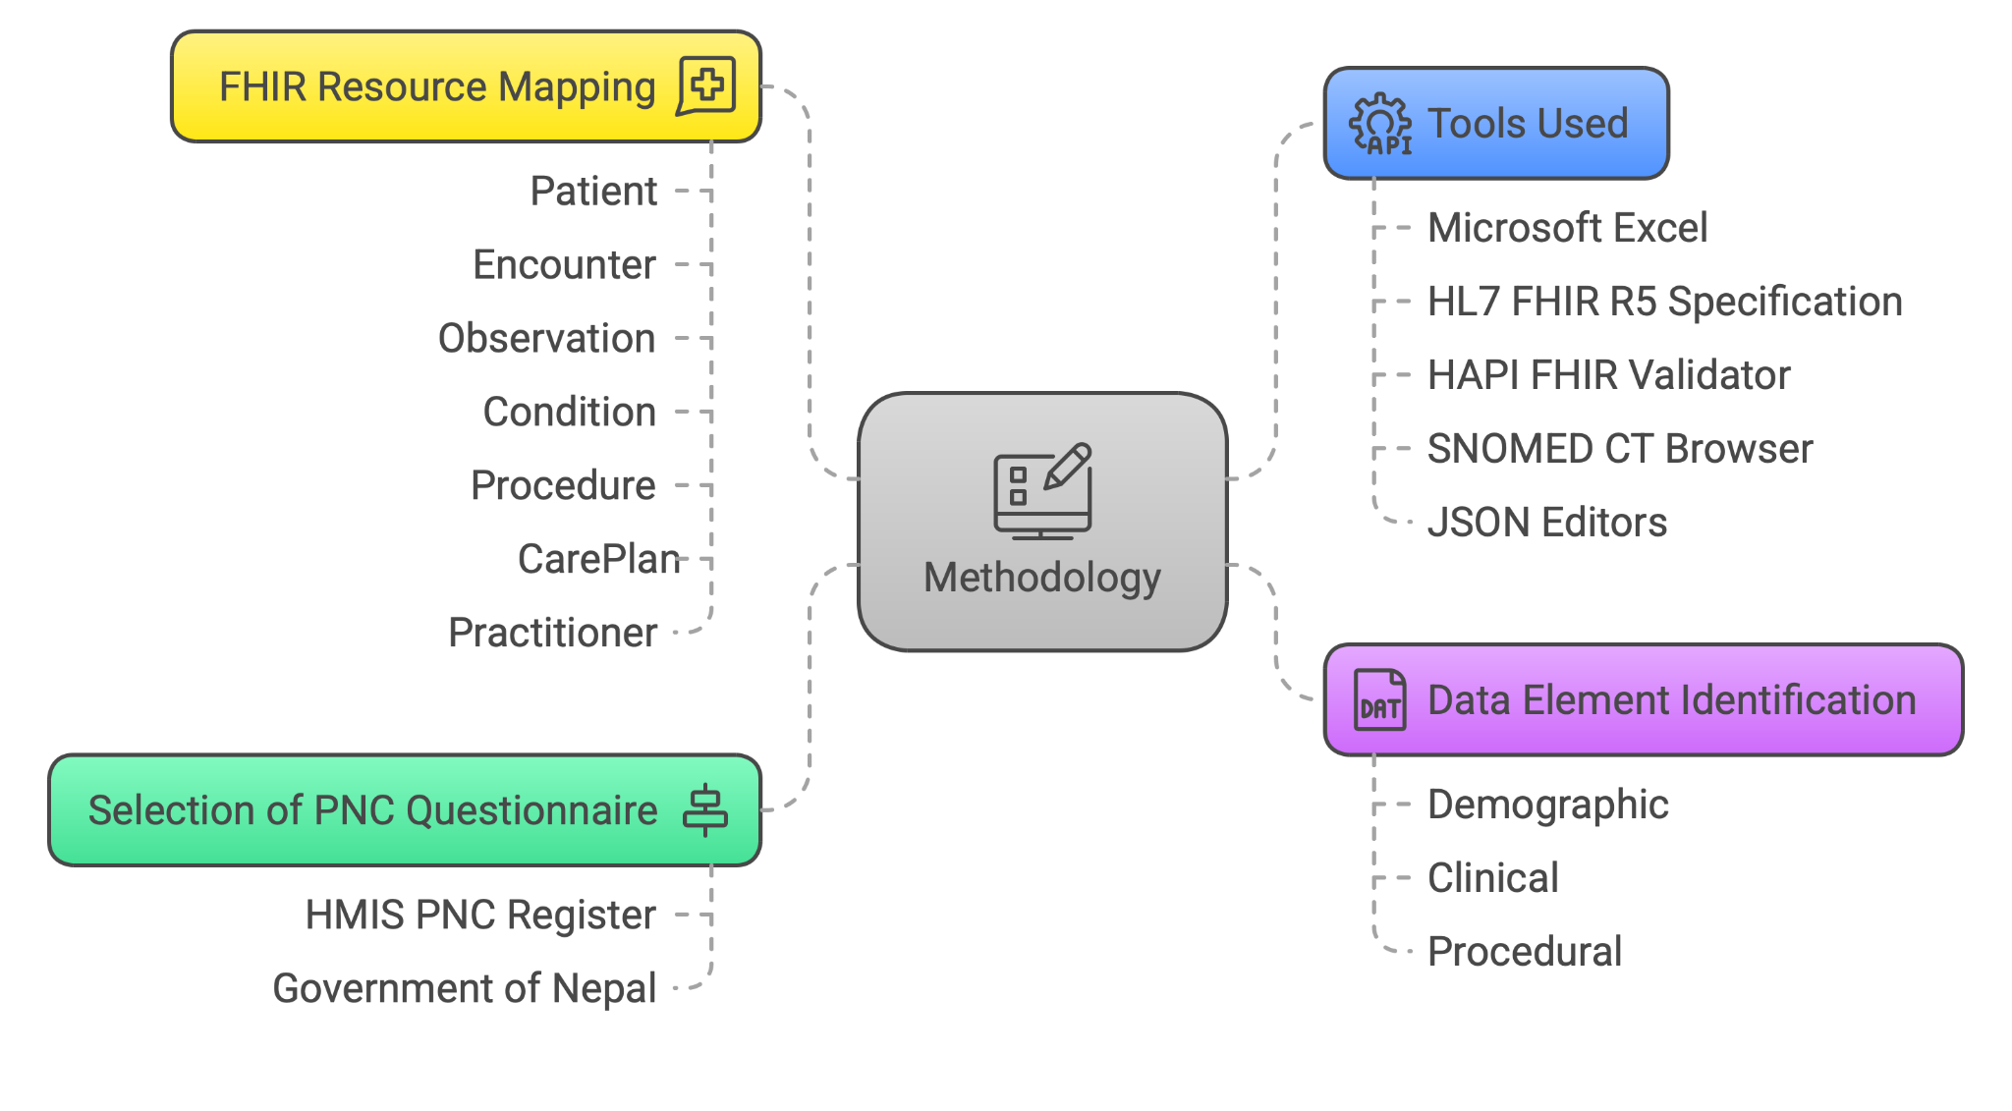

Slide 10
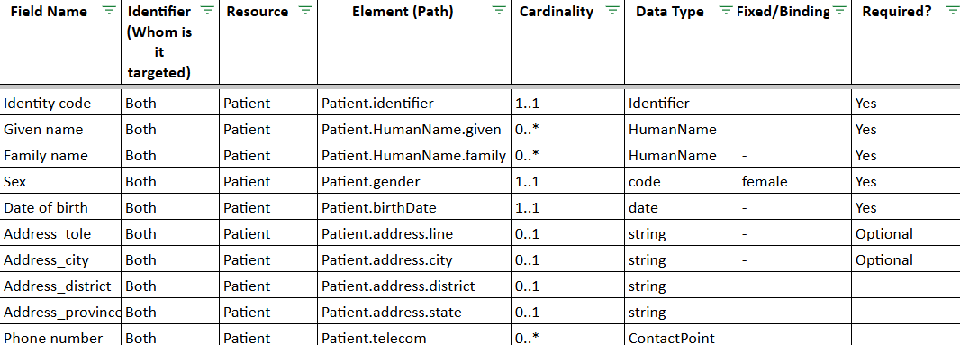
Resource Mapping
{
"id": "Patient.name",
"path": "Patient.name",
"min": 1,
"max": "1",
"type": [
{
"code": "HumanName"
}
],
"short": "Full name of the mother"
},
{
"id": "Patient.gender",
"path": "Patient.gender",
"min": 1,
"max": "1",
"type": [
{
"code": "code"
}
{
"id": "Patient",
"path": "Patient"
},
{
"id": "Patient.identifier",
"path": "Patient.identifier",
"min": 1,
"max": "1",
"type": [
{
"code": "Identifier"
}
],
"short": "PNC ID or national identifier"
Notes:
0..1 = optional, single
1..1 = required, single
0..* = optional, multiple
1..* = required, multiple

Slide 11
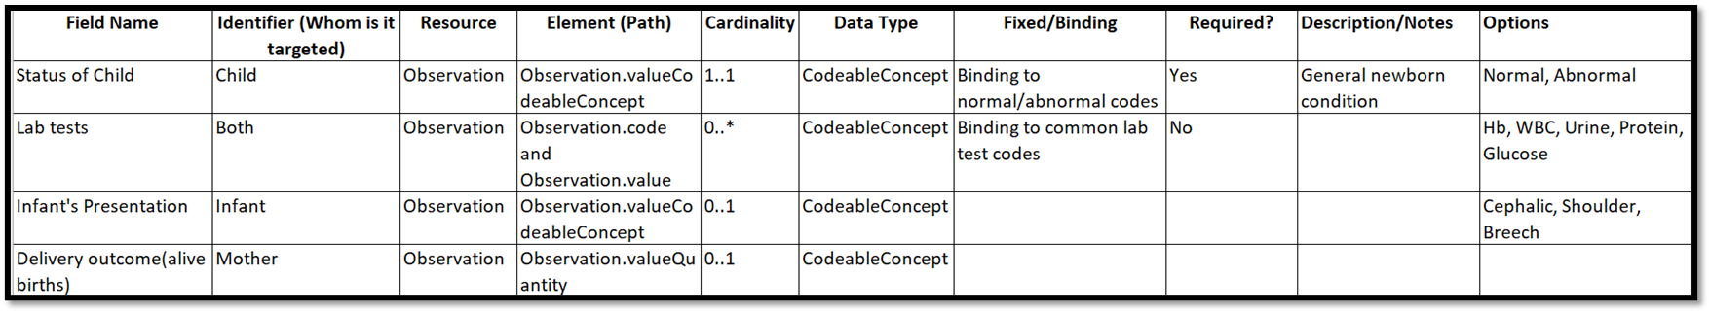
{
"id": "Observation.component:systolic",
"path": "Observation.component",
"sliceName": "systolic",
"definition": {
"code": {
"coding": [
{
"system": "http://loinc.org",
"code": "8480-6",
"display": "Systolic blood pressure"
}
]
},
"valueQuantity": {
"unit": "mmHg",
"system": "http://unitsofmeasure.org",
"code": "mm[Hg]"
}
}
}
Resource Mapping

Slide 12
Field Name | Resource | Element (Path) | Cardinality | Data Type | Fixed/Binding | Required? | Description/Notes | Options
Vitamin A given (mother) | MedicationAdministration | MedicationAdministration.medicationCodeableConcept | 0..1 | CodeableConcept | Binding to supplement valueset | No | Indicates if Vitamin A was given to mother | Yes, No
Number of calcium provided | MedicationAdministration | MedicationAdministration.dosage.dose | 0..1 | Quantity |  | No | Calcium tablets count | Numeric
Number of iron tablets provided | MedicationAdministration | MedicationAdministration.dosage.dose | 0..1 | Quantity |  | No | Iron tablets count | Numeric
Vitamin K for infant | MedicationAdministration | MedicationAdministration.medicationCodeableConcept | 0..1 | CodeableConcept | Binding to medication value set | No | Whether Vitamin K given to newborn | Yes, No
Resource Mapping

Slide 13
Field Name | Resource | Element (Path) | Cardinality | Data Type | Fixed/Binding | Required? | Description/Notes | Options
Treatment | Procedure | Procedure.code | 0..* | CodeableConcept | Binding to treatment/procedure valueset | No | Covers treatments provided including referrals | IV fluids, Uterotonics, Manual removal, Referral
Family planning | Procedure | Procedure.code | 0..1 | CodeableConcept | Binding to family planning service value set | No | Document any FP service provided | Implant, IUCD, None
Vitamin A provided date | Procedure | Procedure.performedDateTime | 0..1 |  | Date | No | Date when Vitamin A was given
Referral | Procedure | Procedure.followUp | 0..1 | CodeableConcept | Binding to referral type | No | Referral during PNC | Mother, Child, Both

Slide 14
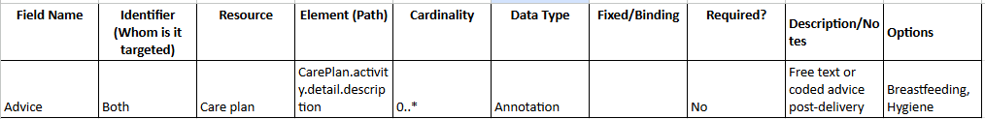
{
"resourceType": "CarePlan",
"id": "pnc-advice",
"meta": {
"versionId": "1",
"profile": [
"http://hl7.org/fhir/StructureDefinition/CarePlan"
],
"security": [
{
"system": "http://terminology.hl7.org/CodeSystem/v3-Confidentiality",
"code": "N",
"display": "Normal"
}
],
"tag": [
{
"system": "http://terminology.hl7.org/CodeSystem/v3-ActReason",
"code": "HTEST",
"display": "test health data"
}
]
},
"status": "completed",
"intent": "plan",
"subject": {
"reference": "Patient/mother-id"
},
"activity": [
{
"detail": {
"description": "Breastfeeding support and nutrition advice",
"status": "completed"
}
}
]
}
Resource Mapping

Slide 15
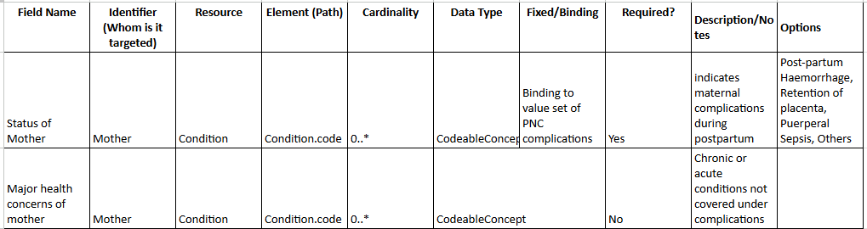
{
"resourceType": "Condition",
"id": "pnc-health-concerns",
"meta": {
"versionId": "1",
"lastUpdated": "2025-05-23T17:00:00+05:45",
"profile": [
"http://example.org/fhir/StructureDefinition/pnc-health-concerns"
]
},
"clinicalStatus": {
"coding": [
{
"system": "http://terminology.hl7.org/CodeSystem/condition-clinical",
"code": "active",
"display": "Active"
}
]
},
"
code": {
"coding": [
{
"system": "http://snomed.info/sct",
"code": "44054006",
"display": "Diabetes mellitus"
}
],
"text": "Chronic or acute conditions not covered under complications"
},
"subject": {
"reference": "Patient/mother-id"
}
}

Slide 16
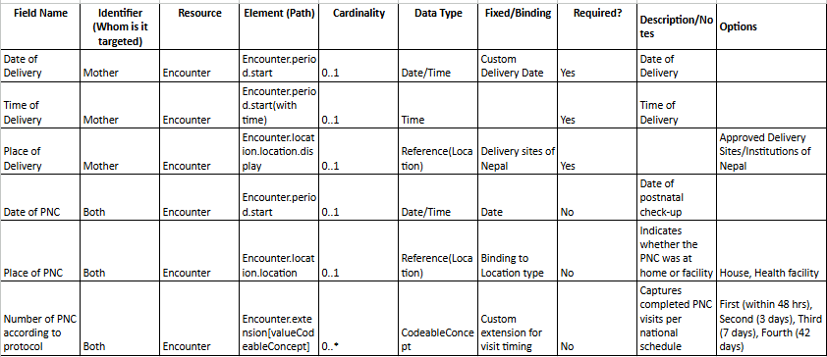
{
"resourceType": "StructureDefinition",
"id": "pnc-encounter-profile",
"url": "http://example.org/fhir/StructureDefinition/pnc-encounter",
"version": "1.0.0",
"name": "PNCEncounterProfile",
"status": "draft",
"date": "2025-05-23",
"publisher": "Your Organization Name",
"description": "Profile of Encounter resource for recording postnatal care (PNC) data.",
"kind": "resource",
"abstract": false,
"type": "Encounter",
"baseDefinition": "http://hl7.org/fhir/StructureDefinition/Encounter",
"derivation": "constraint",
"differential": {
"element": [
{
"type": "Encounter",
"baseDefinition": "http://hl7.org/fhir/StructureDefinition/Encounter",
"derivation": "constraint",
"differential": {
"element": [
{
{
"id": "Encounter.location.location",
"path": "Encounter.location.location",
"binding": {
"strength": "required",
"valueSet": {
"valueSet": "http://example.org/fhir/ValueSet/pnc-location-type"
}
}
},
{
Notes:
An interaction between a patient and healthcare provider(s) for the purpose of providing healthcare service(s) or assessing the health status of a patient. Encounter is primarily used to record information about the actual activities that occurred, where Appointment is used to record planned activities.

Slide 17
The GitHub Project
Repository Contents:
FHIR JSON Templates:
Example files showing how PNC data is structured in FHIR
e.g., Observation_Profile_Validated.json.
Excel Data Dictionary:
Comprehensive mapping of each PNC element to FHIR resources
(PNC PATIENT PROFILE).
Documentation:
Supporting files explaining the mapping and validation process.
Reference Materials:
Scans of the official HMIS register, card and sample data mappings

Slide 18
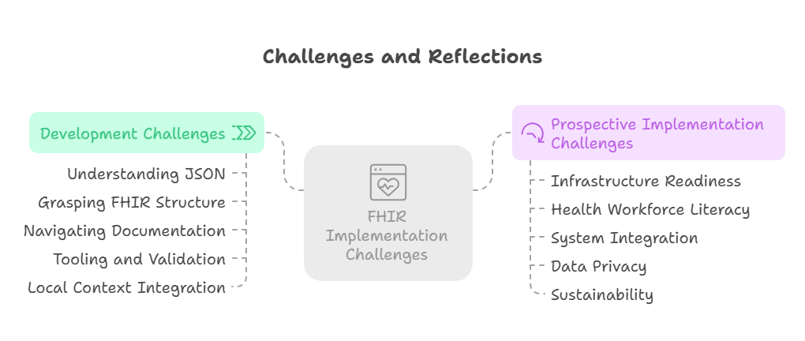

Slide 19
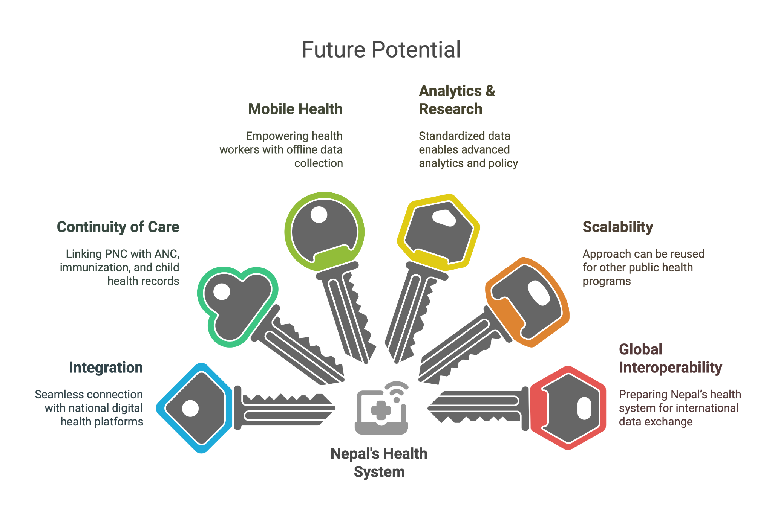

Slide 20
Conclusion
The project demonstrates the feasibility of digitizing Nepal’s PNC register using HL7 FHIR.
Structured mapping to FHIR resources supports interoperability, data quality, and future integration.
The GitHub repository provides a transparent, reusable, and standards-based framework for digital health innovation in Nepal and similar settings
Lays the groundwork for broader digital health transformation in maternal and child health

Slide 21
References
World Health Organization
Health Level Seven International (HL7). (2024). FHIR overview
Ministry of Health and Population Nepal, and others as cited in the report
Department of Health Services. Retrieved June 26, 2025, from https://dohs.gov.np

Slide 22


